Slide 1

STUDENT CERTIFICATES REPOSITORY SYSTEM

Slide 2
GROUP MEMBERS
RUSHIKESH TAYADE – 19101B0008
KUNAL SANWADKAR – 19101B0027
KUNDAN BADHE – 19101B0007
SANKET SAWANT – 19101B0020

Slide 3
WHAT IS CERTIFICATE REPOSITORY?
The Certificate Repository contains the system that holds certificates and information about all unexpired certificates including revocation information.
We can upload our certificates, edit them or we can download them if wanted.

Slide 4

VIEW OF OUR WEBSITE

Slide 5
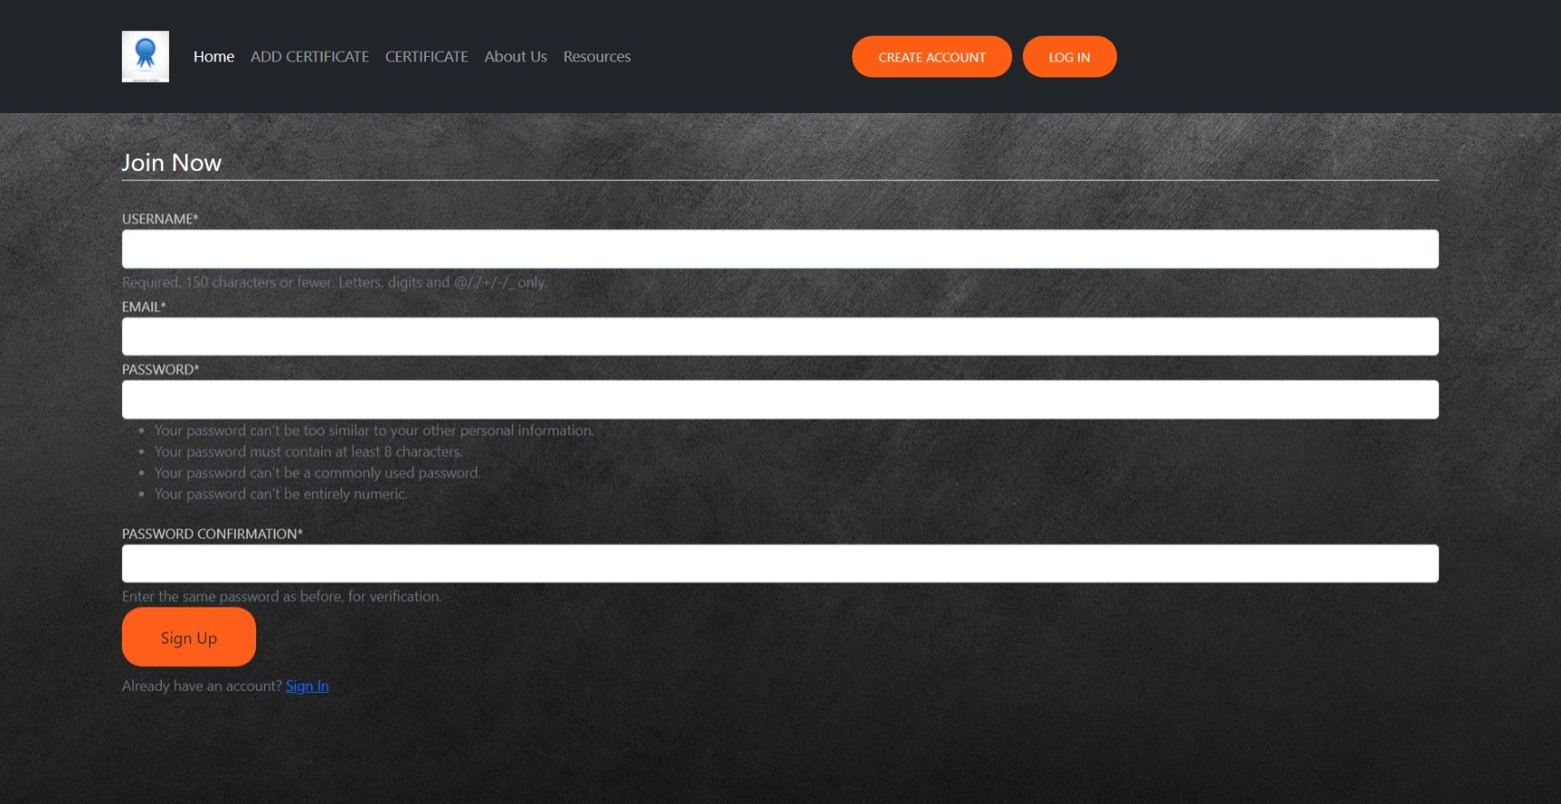
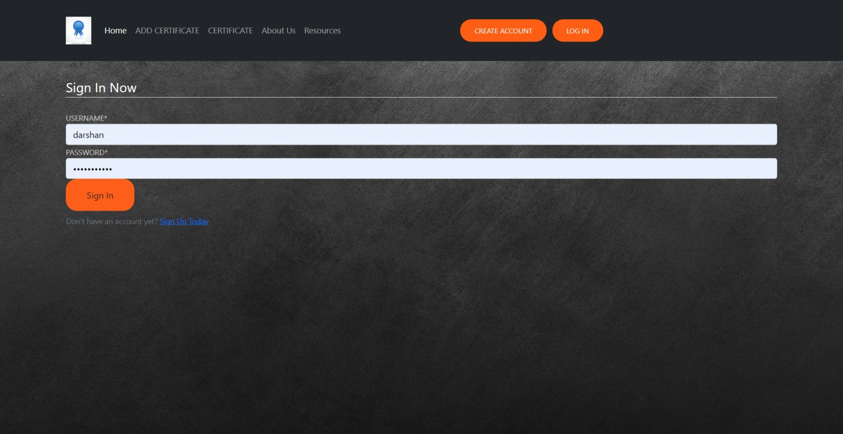
Authentication
Registration
Sign IN

Slide 6
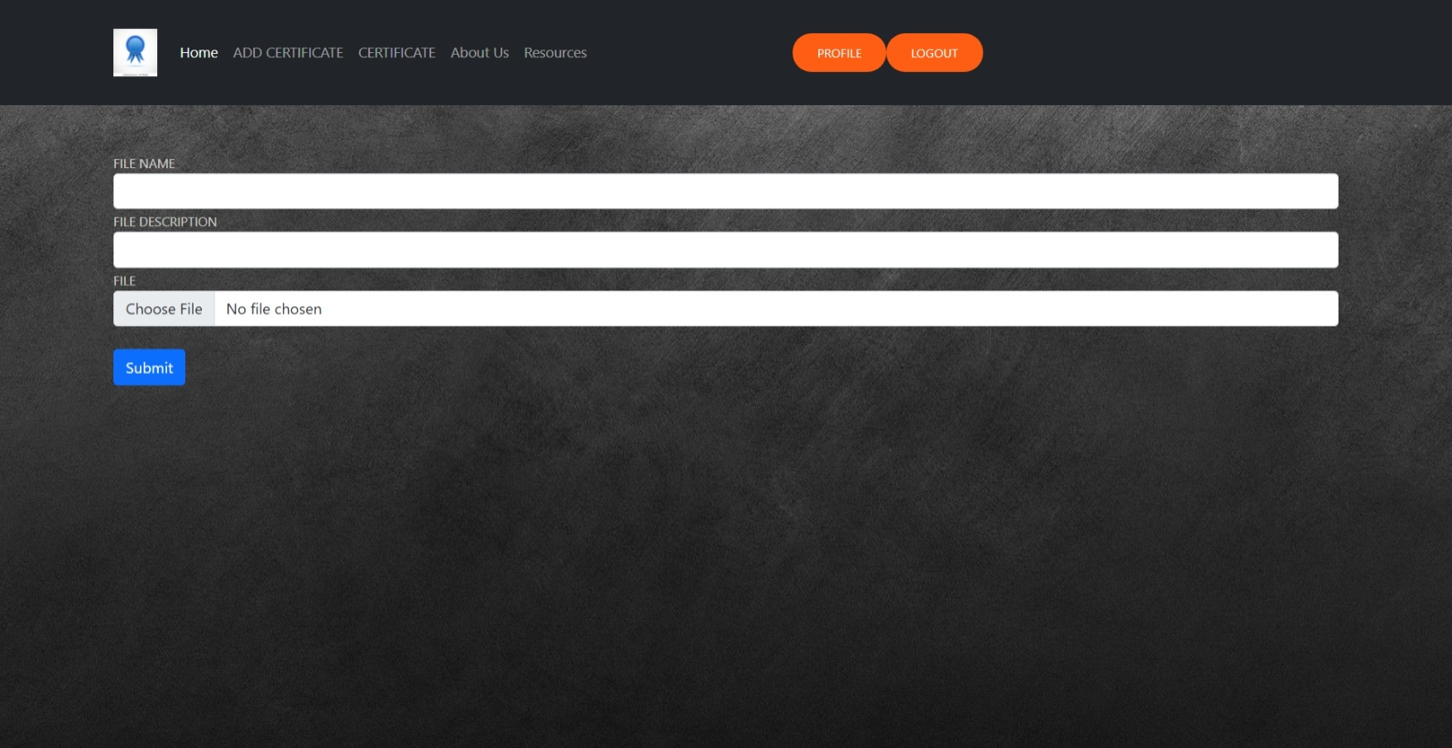
ADD YOUR FIRST CERTIFICATE

Slide 7
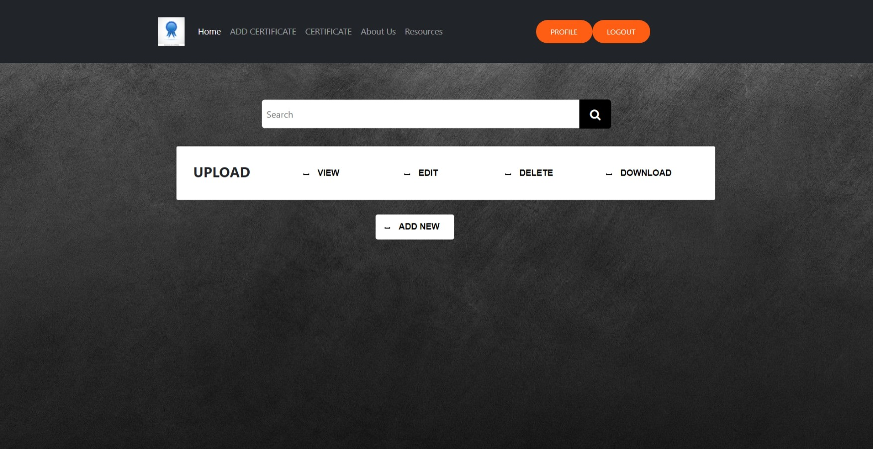
VIEW YOUR CERTIFICATE

Slide 8
ADVANTAGES
Due to this website storing our certificates gets easy.
As the website is secure, so there is no need to worry about anything.
User can Download or view Certificate just with one click.
Easy Authentication.
Supports all file types like pdf, jpeg, etc

Slide 9
LANGUAGES USED
Scripting: HTML
Designing: CSS & Bootstrap
Backend: Django framework
Database: Sqlite
IDE : VS code

Slide 10
References
Youtube
Stack Overflow
Tutorials Point
Learndjango.com
W3schools

Slide 11
THANK YOU!

